Slide 1
IN THE NAME OF GOD

Slide 2
General Management of Poisoned Patients
kavous Shahsavari Nia. MD
Emergency Medicine Specialist
Assistant professor of Emergency Medicine
Faculty of Medicine Tabriz University of Medical Sciences
Tabriz, Iran

Slide 3
Objectives
1-Toxicology
2- Side effect
3- Poisoning
4- Intoxication
5- Over dose
5- Management of intoxicate patient
6-Disposition

Slide 4
Introduction
All substances have the potential to be poisons
Poisoning occurs when exposure to a substance adversely affects the function of any system within an organism
The setting of the poison exposure may be occupational, environmental, recreational, medicinal
Poisoning may result from accidental or intentional
Poisoning may result from varied portals of entry, including:
inhalation, insufflation, ingestion, cutaneous, mucous membrane,
injection

Slide 5
ED Diagnosis
History:
It is often difficult to obtain a reliable and accurate history from overdose patients
1- alteration of mental status 2- underlying motivations
3- secondary gains 4- risk of arrest
Obtain as much information as possible about the exposure
about the agent or drug, amount or dose, route of exposure, other individuals were
exposed
Corroborating information should be obtained from:
The patient's physician, Prior medical records, Witnesses, EMS
Ask about the environment in which the patient was found:
the presence of empty pill bottles or containers nearby, any smells or unusual
materials in the home, the occupation or hobbies of the patient, and the presence of a
suicide note

Slide 6
Physical Examination:
An organized approach is recommended when evaluating patients with potential toxic exposures
Undress the patient completely and check substances hidden on the patient's body (groin, between skinfolds)
Check the patient's clothing for objects or substances still retained in the pockets
Search clothing and belongings(waistband) with care to avoid being injured by uncapped needles or sharp objects
Any odors on the patient's clothes should be noted

Slide 7
Vital Signs:
- You must obtain a full set of vital signs, including blood glucose
- Vital signs are the key to your initial management of the patient
Assess the general appearance of the patient and note any agitation, confusion(AMS)
Examine the skin for:
cyanosis or flushing, excessive diaphoresis or dryness, signs of injury or
injection, ulcers, bullae
- Bruising may be a clue to trauma, a prolonged duration of unconsciousness,
coagulopathy

Slide 8
Examine the eyes for:
pupil size, reactivity, nystagmus, dysconjugate gaze, excessive lacrimation
Examine the oropharynx for:
hyper salivation or excessive dryness
Auscultate the lung fields to assess for:
bronchorrhea or wheezing
Auscultate the heart for:
rhythm, rate, and regularity

Slide 9
Examine the abdomen for:
noting the presence of bowel sounds, enlarged bladder, and abdominal
tenderness or rigidity
Examine the extremities for:
muscle tone and note any tremor or fasciculation
If the patient's condition allows a more intensive neurologic assessment of:
cognition, cranial nerves, tendon reflexes, muscle strength, coordination, gait

Slide 10
Toxidromes
Toxidromes are collections of physical findings that occur with specific classes of substances

Slide 11
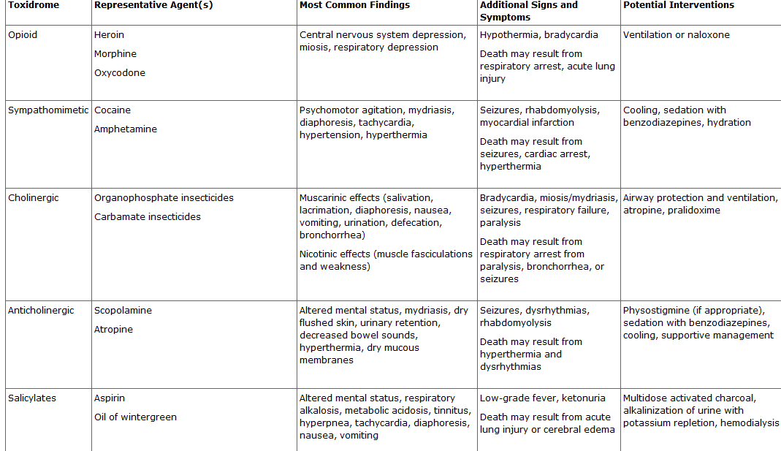

Slide 12
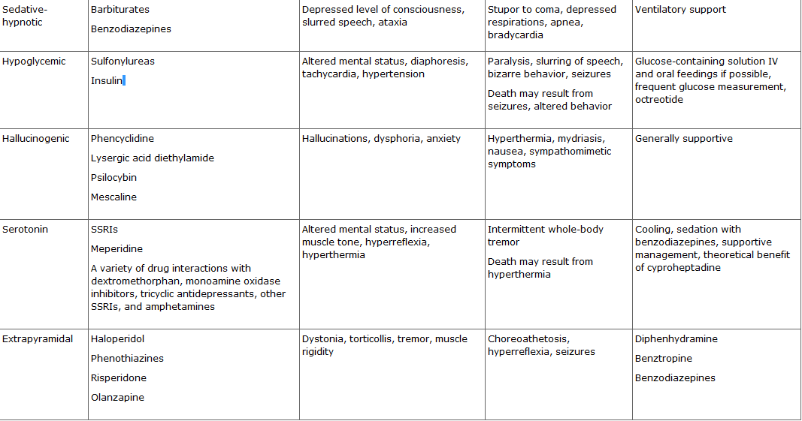

Slide 13
Toxicological Screen
In the emergency setting, toxicological screening tests of blood and/or urine do not contribute significantly to the evaluation, management, or outcome for most patients
Substances for which serum level may affect therapy
Acetaminophen , Salicylate, Lithium , Digoxin ,Valproate ,
Phenytoin , Iron, Carbamazepine ,Theophylline, Carbon monoxide
Methemoglobin , Methanol, Ethylene glycol , Paraquat
The diagnosis of less frequently encountered exposures usually
requires specialized testing that is not obtainable in a timely manner

Slide 14
Positive results
- May not be related to the acute symptoms:
because many substances persist in body fluids for days to weeks, depending on
the chronicity of use
- May occur from substances that cross-react with the assay:
*pseudoephedrine, oxymetazoline, methylphenidate, selegiline for
Amphetamines
*chlorpromazine, cyclobenzaprine, thioridazine, diphenhydramine,
cyproheptadine, carbamazepine for TCA

Slide 15
Negative results:
- May be due to sampling error
*very dilute urine after hydration
- May be not assay specificity
*Opioid screens do not detect methadone and meperidine
*Amphetamine screens do not detect 3,4methylenedioxy- methamphetamine
known as "ecstasy" (shortened to "E", "X", or "XTC")
*Benzodiazepine screens do not detect flunitrazepam (known as Rohypnol)

Slide 16
ED Management
The first priority is CABs (Circulation , Airway , Breathing)
ED diagnosis (History, Physical Exam, Toxicological Screen)
Approch to LOC!
Antidotes:
Use of antidotes is essential in the treatment of poisoned
patients, only in very rare instances (cyanide poisoning)
does the administration of an antidote after ABCs
General Decontamination

Slide 17
Approach to LOC
Patients with LOC may have : hypoxia, opioid intoxication,
hypoglycemia, Wernicke encephalopathy
Empiric administration of antidotes (coma cocktail) including :
oxygen, naloxone, glucose, thiamine
should be considered after the medical history, vital signs, immediately available laboratory data
O2 therapy
IV Glucose should be administered when serum glucose level
cannot be rapidly ascertained or hypoglycemia is confirmed
IV Thiamine
acute Wernicke encephalopathy

Slide 18
IV/IM Naloxone
- competitive opioid antagonist without any intrinsic toxicity
- Apnea, Gasping, Hypoventilation (RR <12/min)
- Using myosis as the sole indication for naloxone administration is
unreliable, because many other toxins can produce small pupils along
with mental status depression, and some opioids classically leave
pupil size unaltered (meperidine, propoxyphene)
- Side effect: acute opioid withdrawal syndrome
is never life-threatening in adults 1)Agitation
2)Vomiting (aspiration)

Slide 19
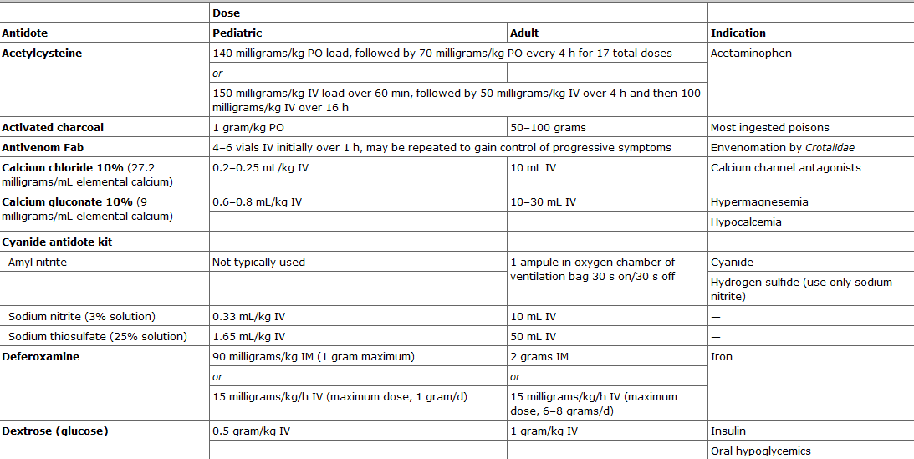

Slide 20
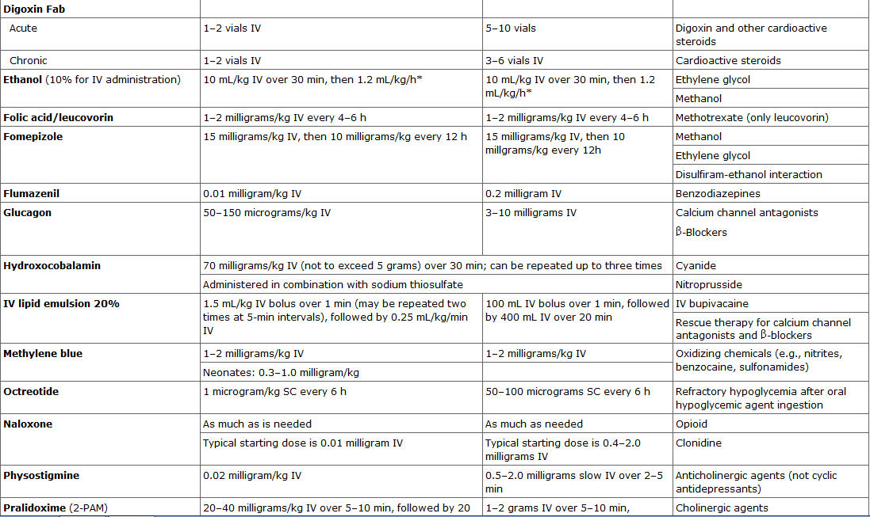

Slide 21
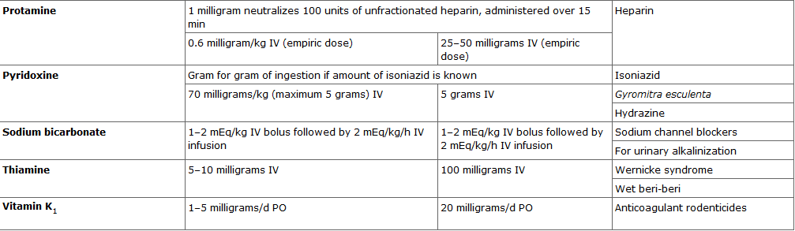

Slide 22
General Decontamination
The general approach to most toxic exposures involves the removal of the patient from the substance and the substance from the patient
Four Method :
1- Gross Decontamination
2- Eye Decontamination
3- GI Decontamination
4- Enhanced Elimination

Slide 23
Gross Decontamination
Surface decontamination is achieved by completely undressing patients and thoroughly washing them with copious amounts of water
Patients requiring assistance should be attended to by properly gowned staff
The towels used to dry patients and patients' clothing, shoes, socks, watches, and jewelry should be handled as contaminated material
If possible, surface decontamination should occur prior to the patient's entry into the ED or other areas in the hospital
In mass casualty exposures, this typically occurs at a staging area adjacent to the ED

Slide 24
Eye Decontamination
Use of:
1- lid retractors may be required for adequate irrigation
2-Ophthalmic anesthetic(0.5% tetracaine) relieve belpharospasm and facilitate
irrigation
3- Normal saline or lactated Ringer's solution
(1 to 2 L per eye depending on the agent)
In cases of ocular exposure to Acids or Alkalines
- Acids produce coagulation of an epithelial surface that limits further penetration
- Alkalines produce liquefaction that enables the chemical to penetrate deep into tissues
- Lengthy continuous irrigation (possibly 1 even 2 hours) may be required, until the tears
in the conjunctival sac have stabilized to a pH of <8
- A period of 10 minutes or longer after the cessation of irrigation may be required for
accurate pH determination of the tears
- Ophthalmologic consultation is recommended

Slide 25
GI Decontamination
Gastric Emptying:
1- Emesis
2- Oro/Naso gastric Lavage
Toxin Adsorption in the Gut:
1- Activated Charcoal
2- Multi dose Activated Charcoal
Enhancement of Bowel Transit:
1- Cathartics
2- Whole-Bowel Irrigation

Slide 26
Emesis
Ipecac syrup
Is a plant-derived compound composed of two alkaloidal substances emetine and cephaeline
That work both peripherally on the stomach and centrally on the chemotactic trigger zone to induce vomiting
The typical dose is 15 mL for children 1 to 12 years of age and 30 mL for adults, usually followed by sips of water. The dose may be repeated only once if vomiting does not occur within 30 minutes
Approximately 90% of patients vomit within 20 minutes after the first dose, and up to 97% vomit after a second dose
The typical patient vomits fewer than five times, and symptoms usually resolve within 2 hours

Slide 27
Ipecac administration has not been shown to alter outcome compared to treatment with activated charcoal alone
Ipecac should be used only in rare circumstances:
1- Immediately after ingestion of a substance not expected to compromise the
airway or lead to altered mental status, hemodynamic derangement, seizure
2- After recent ingestion of a highly toxic pill that is known not to fit into the
holes of the appropriately sized orogastric tube
Contraindications :
1- Ingestions that have the potential to alter mental status
2- Active or prior vomiting
3- Caustic ingestion
4- Exposure to a toxin with more pulmonary toxicity from inhalation than
toxicity from GI absorption (hydrocarbons)
5- Ingestions of toxins that have the potential for inducing seizures
Complications :
1- Aspiration 2- Boerhaave syndrome
3- Mallory-Weiss tear 4- Intractable vomiting

Slide 28
Oro /Naso gastric Lavage
Despite evidence that gastric emptying times are prolonged in some overdoses clinical efficacy of orogastric lavage has been found only in small numbers of patients in whom it is initiated within 1 hour of ingestion
Recommendation of orogastric lavage is generally limited to cases of recent ingestion of a life-threatening toxin
The orogastric tube should be of adequate size to recover pill fragments:
36F to 40F (12- to 13-mm outside diameter) for adults and 22F to 24F (8- to 9-mm
outside diameter) for children
The tube is inserted to a depth that corresponds to the length from the patient's chin to the xiphoid process
Correct tube positioning is assessed by insufflation of air

Slide 29
The patient is typically positioned on the left side (left lateral decubitus) with the bed tilted head down 20 degrees to reduce the risk of pulmonary aspiration
Perform lavage with small amounts of fluid, 200 to 300 mL in adults and 10 mL/kg in children, to avoid stimulating the propulsion of gastric contents into the duodenum
Gastric lavage with cool solutions can induce hypothermia, so use of body-temperature or at least room-temperature solutions is recommended
The volume returned with lavage should be essentially equal to that administered
Lavage is commonly continued until the effluent becomes clear
Before the tube is removed, if indicated activated charcoal should be instilled

Slide 30
Complications:
1- Insertion of the tube into the trachea 2- Aspiration
3- Esophageal or gastric perforation 4- Hypoxemia during the procedure
Contraindications:
1- Ingestion of pills that are known not to fit into the holes OGT /NGT
2- Nontoxic ingestions
3- Non–life-threatening ingestions
4- Caustic ingestions
5- Lack of assurance of airway integrity
6- Toxic ingestions that are more damaging to the lungs than the GI tract, such as
hydrocarbons that pose a greater risk from pulmonary aspiration than from
gastrointestinal absorption
.

Slide 31
Activated Charcoal
Activated charcoal works by adsorbing substances in the gut lumen via Van der Waals forces, which makes them less available for absorption into the tissues
Most organic and some inorganic substances are absorbed by activated charcoal
Activated charcoal can also bind substances excreted in the bile, interrupting entero hepatic circulation
The benefits of this technique include without requiring invasive procedures, the rapidity of its administration
Its overall safety in both adults and children
Clinical benefit is more likely if activated charcoal is administered within 1 hour of toxin ingestion, but that potential benefit of administration after more than 1 hour cannot be excluded

Slide 32
Activated charcoal is typically given in a slurry of water or juice by mouth or through a nasogastric tube
Recommended dosing is a 10: 1 ratio of activated charcoal to drug, which is thought to be the smallest dose of activated charcoal that can be given without reducing its efficacy, or 1 gram/kg, whichever is larger
Indications :
recent ingestion of any drug known to adsorb to it or ingestion of an unknown
or ingestion of an unknown agent by a patient with a protected airway
Contraindication:
1- Esophageal or gastric perforation (even suspected)
2- Emergency endoscopy if needed
Complications: (are exceedingly rare)
1- aspiration 2- intraluminal impaction (in patients with abnormal gut motility)
No indication (Not contraindication):
isolated ingestion of substances known to adsorb poorly onto it (iron, lithium,
lead, hydrocarbons, toxic alcohols)

Slide 33
Multi dose Activated Charcoal
Multi dose activated charcoal entails the repeated use of activated charcoal to enhance elimination of ingested toxins
Indications:
1- Toxins with a long half-life
2- Small volume of distribution
3- Form bezoars in the GI tract
4- Slow gut function
5- Released slowly into the gut lumen
6- Have enterohepatic - enteroenteric circulation
5- Theophylline, Carbamazepine, Phenobarbital, Quinine, Dapsone

Slide 34
First dose of 1 gr/kg (50 to 100 grams) followed by subsequent doses of 0.25 to 0.50 gr/kg (12.5 grams)
Repeated one to 3 times at intervals ranging from 1 to 4 hours
Intubated patients who have ingested life-threatening toxins often have decreased gut motility and might benefit from multiple doses, but the stomach should be suctioned before administration of the next dose of activated charcoal to minimize gastric distention
Contraindication:
in patients with non–life-threatening ingestions that result in
decreased gut motility because of increased risks of aspiration
from gastric distention and impaction of charcoal within the gut

Slide 35
Cathartics
Activated charcoal is often administered with an osmotic cathartic, such as 70% sorbitol (1 gram/kg) or a 10% solution of magnesium citrate (250 mL for adults and 4 mL/kg for children)
Cathartics decrease the transit time for the passage of the activated charcoal (and presumably the adsorbed toxin) through the GI tract
Cathartics alone not reduces drug absorption
When multi dose activated charcoal is used, only the first dose is accompanied by a cathartic to limit complications

Slide 36
Complications :
Nausea, Abdominal pain, Severe volume depletion, Electrolyte imbalances
and Fluid shifts, Hyper magnesemia in patients with renal compromise
Contraindications:
1- Ingestion of a substance that will result in diarrhea
2- Age of <5 years
3- Renal failure (magnesium-containing cathartics are contraindicated)
4- Intestinal obstruction
5- Ingestion of any caustic material

Slide 37
Whole-Bowel Irrigation
Whole-bowel irrigation is performed by the instillation of large volumes of polyethylene glycol in an osmotically balanced electrolyte solution that produces rapid catharsis by mechanically forcing ingested substances through the bowel at an accelerated rate. The balanced electrolyte solution prevents fluid and electrolyte shifts
Whole-bowel irrigation is best accomplished by infusing the polyethylene glycol solution through a oral or nasogastric tube
Typical doses are 1.5 to 2.0 L/h in adults, 1 L/h in children 6 to 12 years of age, and 0.5 L/h in children <6 years of age
Tolerance to the volumes infused may limit the rate of administration
The end point of treatment is clear rectal effluent

Slide 38
Contraindications:
1- Preceding diarrhea
2- Ingestion of substances that are expected to result in significant diarrhea
(except for heavy metals, because these substances do not adsorb well to activated
charcoal)
3- Bowel obstruction( evidenced by lack of bowel sounds)
Complications:
1- Bloating
2- Cramping
3- Rectal irritation (frequent bowel movements)
Administration of an antiemetic is frequently required to control the nausea and vomiting that occur with gastric distention resulting from the large volumes of whole-bowel irrigation solution used
- Metoclopramide or Ondansetron
- Avoid phenothiazine-derived antiemetics (slow gut function)

Slide 39
Ingestions for Which Whole-Bowel Irrigation may be helpful
1- Sustained or delayed-release formulations
2- Agents with potential for bezoar formation
3- Iron and other heavy metals
4- Paint chips containing lead
5- Lithium
6-Drugs carried by body stuffers and body packers

Slide 40
Enhanced Elimination
1-Urinary Alkalinization
2-Urinary Acidification
3- Forced Diuresis
4-Hemodialysis/Hemoperfusion

Slide 41
Urinary Alkalinization
Manipulation of urinary pH toward alkaline is done to enhance the clearance of specific toxins
This treatment is based on two principles:
1- The first is that only nonionized substances are free to move
passively across membranes, whereas ionized particles must
remain in the fluid-filled compartments in which they were formed
("ion trap")
2- The second is that weak acids or bases become more ionized in the
opposite environment

Slide 42
After IV administration, bicarbonate becomes concentrated in the urine, which results in significant elevation of urinary pH (provided the patient has a normal serum potassium level). When the urinary pH is significantly raised, toxins that are weak acids dissolved in the urine are converted from their non ionized form to their ionized form, which thereby traps the drug within the urine.
Voiding of this urine increases the concentration gradient of the toxin between the blood and the urinary collection system, which draws more toxin into the renal tubular lumen.
The ideal toxin for elimination by urinary alkalinization is one with substantial urinary excretion and with a pKa (negative logarithm of the acid ionization constant) less than the serum pH.

Slide 43
Urinary alkalinization is typically achieved by the administration of sodium bicarbonate as either a 1 to 2 mEq/kg IV bolus or 3 to 4 mEq/kg IV infusion over 1 hour
Sodium bicarbonate is given as an initial IV bolus of 1 to 2 mEq/kg, which can be repeated until patient improvement is noted or until blood pH equals 7.50 to 7.55. Alkalinization beyond this point can be deleterious and therefore is discouraged. Continuous infusions of sodium bicarbonate are administered as 150 mEq added to 1 L of 5% dextrose in water (or 100 mEq added to 5% dextrose in 0.45% saline—a slightly hypertonic solution with the sodium bicarbonate added) and infused IV at a rate of 2 to 3 mL/kg/h. Adjustments in the IV rate are made based on blood pH measurements, serum sodium level, and clinical response to therapy. Hypokalemia is an expected complication of sodium bicarbonate therapy. IV potassium supplementation usually is required, and serum potassium levels should be measured frequently
Urinary pH should be monitored frequently (every 15 to 30 minutes) until the urine pH is 7.5 to 8.5 and Serum pH should not be allowed to rise above 7.5 to 7.55
Pronounced hypokalemia may result from this procedure and should be corrected to maintain treatment benefit. Hypokalemia induces the kidneys to reabsorb potassium and excrete hydrogen ions, which inhibits the production of alkaline urine. This may result in relatively acidic urine when compared with the serum pH

Slide 44
Complications:
1- Volume overload (heart failure and pulmonary edema)
2- PH shifts
3- Hypokalemia
4- Hypernatremia
Contraindications:
1- Hypernatremia
2- Hypokalemic
3- Renal insufficiency
4- Heart Failure

Slide 45
Urinary Acidification
Acidification can enhance the elimination of weak bases
- Amphetamines
- Phencyclidine
Risk is rhabdomyolysis (far outweigh any benefits)

Slide 46
Forced Diuresis
Forced diuresis has never been shown to be effective for ingestion of any toxin
Chlorophenoxy herbicides when diuresis is combined with urinary
alkalinization

Slide 47
Hemodialysis
Hemodialysis is generally reserved for specific toxins that are both potentially life-threatening and amenable to removal by this method
The benefits include the ability to remove toxins that have already been absorbed from the gut lumen, to remove substances that do not adhere to activated charcoal, and to remove both the parent compound and the active toxic metabolites
Less effective:
1- Toxin ingested has a large volume of distribution (>1 L/kg)
2- Has a large molecular weight (>500 Da)
3- Highly protein bound

Slide 48
Contraindication (absolutely):
1- Patients with hemodynamic instability
2- Very small children
3- Patients with poor vascular access
4- Profound bleeding diatheses
Complication (minimal):
1- Large fluid shifts
2- Electrolyte imbalances
3- Infection and bleeding at the catheter site
4- Intracranial hemorrhage from the required anticoagulation

Slide 49
Hemoperfusion
Which is also used for decontamination of a patient's systemic
circulation, involves placing a filter filled with activated charcoal
into the circuit of the hemodialysis device
This filtration alleviates the constraints of protein binding and molecular size, both of which limit the utility of hemodialysis
Toxins that can be removed by this method must adsorb well to
activated charcoal and have a small volume of distribution

Slide 50
Examples:
Salicylates (Hemodialysis recommended in severe ingestions)
Methanol (Hemodialysis)
Ethylene glycol (Hemodialysis)
Lithium (Hemodialysis)
Theophylline (Hemodialysis, Hemoperfusion)
Carbamazepine (Hemodialysis, Hemoperfusion)
Amanita (Hemodialysis, Hemoperfusion)
Phenobarbital (Hemoperfusion)
Phenytoin (Hemoperfusion)
Eth chlorvynol (Hemoperfusion)

Slide 51
THANKS
?

